Slide 1


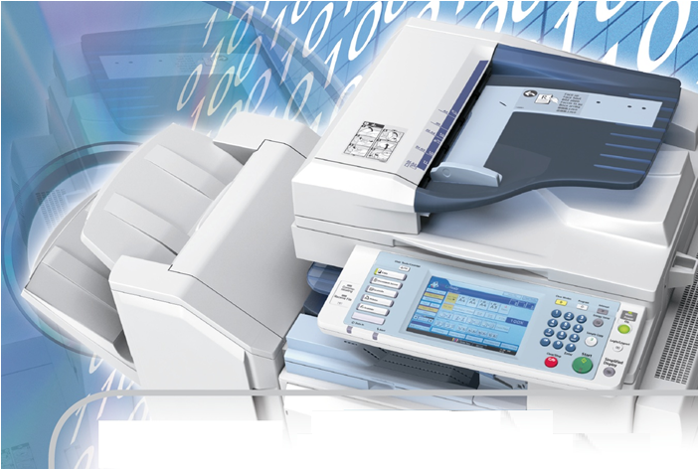

Technical
Presentation
W-ELP
Welcome
Notes:
On request is this presentation also available in PowerPoint format.

Slide 2
ELP Technical Presentation
!
Explanatory note:
This document explains the technical possibilities of ELP and it is not supposed to be a selftraining.
For receiving a training please have a look into the self training manual:
http://welp.stethos.com/online-help/selftraining.html

Slide 3
Agenda
Part I: Introduction
Requirements
Overview
Download free trial version
Installation on MS Windows
Licenses
Part II: Basic Features
  Quick Sets
  Forms
  Applying Rules
  Variables
  Bar codes
  Archiving
Part III: Advanced Features
Digital Signature
Distributed Printing
Reporting and Accounting
  E-mail
  Emulations & other solutions
Summary & Wrap up

Slide 4
Requirements
OS platform
Name | Supported platforms | Remarks
W-ELP | Windows XP, 2003, Vista, 7, 2008, 2008R2, 8, 2012, Cluster/Terminal server; 32/64bit | Enhanced features available (like e-mail support, digitally signed PDFs etc.)
X-ELP | Linux, Solaris, HP-UX, AIX, True64, VMS | Other Unix platforms can be supported upon request
B-ELP | IBM iSeries and AS/400 | Not all W-ELP functions are supported
AP-ELP | Networked Ethernet appliance which works in a TCP/IP printing environment | Optional output methods like USB or Parallel port possible, up to 56 printers can be connected
I-ELP* | Internal printer/MFP based (product is shipped on a memory flash card, existing hard disk of MFP’s can be used as well) | Sold as IBS in the “Ricoh world” Soald as HP-ELP in HP world
OEM-ELP* | Depends on the 3rd party vendor | Always bundled with a 3rd party vendor application
S-ELP* | ANSI-C Compiler needed | Source code is supplied to the customer, various Terms and Conditions of usage are possible

Slide 5
Requirements
Printer Drivers
PCL5 printer driver
For Windows:
  Data stream contents may vary between different drivers, operating systems and used applications!
  Recommended Windows drivers if no device specific PCL5 driver is available from your vendor:
    HP Color LaserJet 9500 PCL5c
    Ricoh Aficio MP C300 PCL5c
  Note: any required printer options can be setup using ELP.

Slide 6
Implementation in
MS Windows
MS Windows
Application
ELP System
EMF/XPS
starts
Driver
ELP Kernel
Software
Driver: GDI
to
PCL
Data Entry via
LPR Daemon
Share Name
Port
QUEUE Management
out
file
2. Read back
W-ELP Print Processor
1. check trg file
Port Monitor
User System with
Distribute Data
USER rights
Windows Installation

Slide 7
Feature Overview
Forms and printer handling,
  e. g. stapling, tray handling, carbon copies and 50 more combinable functions
Accounting and reporting
Archiving, collecting and reprinting
Distributed printing, workload balancing
Bar codes and OMR (envelope inserters)
E-mail and fax
Emulations and data stream manipulation
Monitored printing
Unicode / Asian printing
Toolbox with more than 300 functions
In deed a multi-purpose tool just like a swiss arm knife!

Slide 8
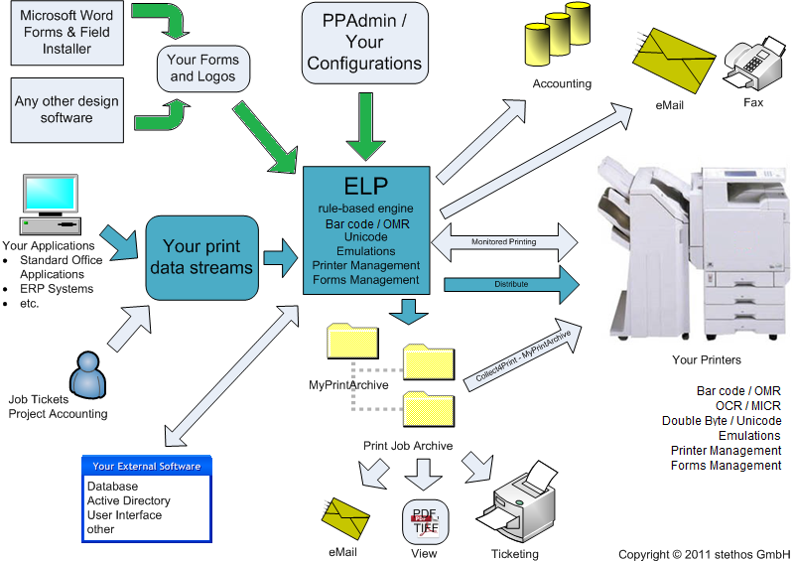
Overview

Slide 9
Overview

Slide 10

Download free trial version
Notes:
On request is this presentation also available in PowerPoint format.

Slide 11
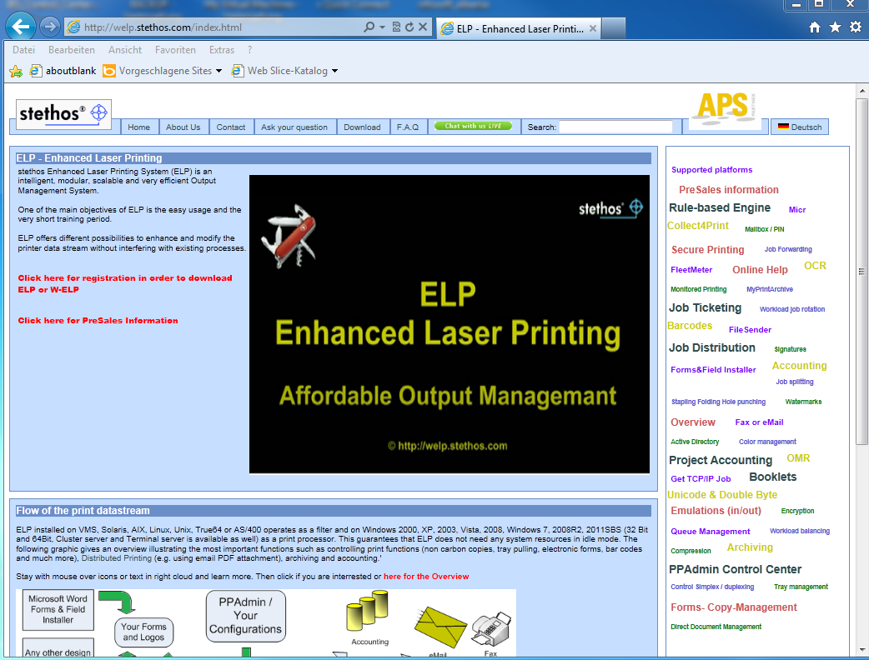
Download of
ELP trial version
Go to http://welp.stethos.com
Follow the download link
Installation

Slide 12
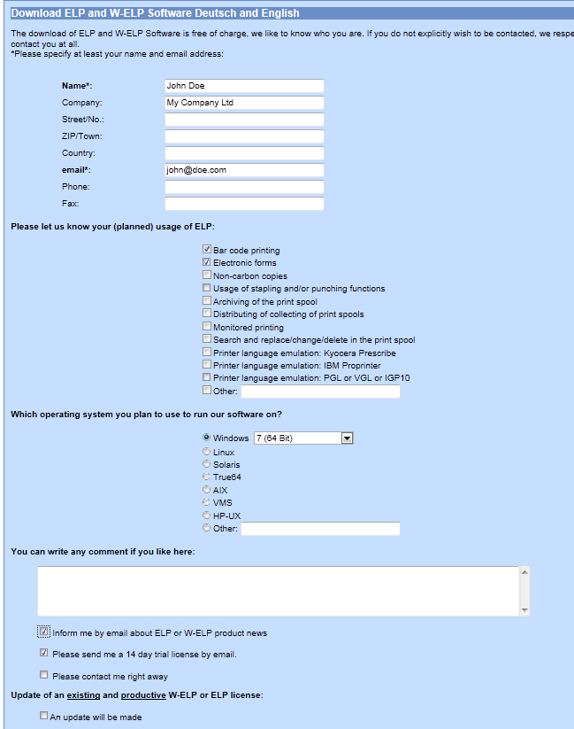
Download of
ELP trial version
Go to http://welp.stethos.com
Follow the download link
Fill in the forms
Installation

Slide 13
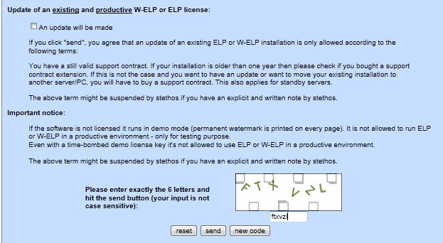
Download of
ELP trial version
Go to http://welp.stethos.com
Follow the download link
Fill in the forms
Fill in the capture and click on send
Installation

Slide 14
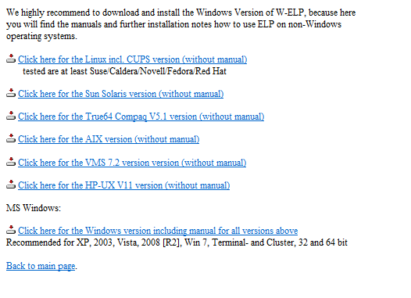
Download of
ELP trial version
Go to http://welp.stethos.com
Follow the download link
Fill in the forms
Fill in the capture and click on send
Download the Test Version for your platform
Note: non-Windows users should additionally download the Windows version
Installation

Slide 15

Installation:
Unix, Linux, etc.
Requirements: PCL 5e/c data streams, any other for basic functions
Software installation process
1. Download dialect specific package from product website
2. Unpack into any directory, all files in lower case!
3. Set the convert file to executable: chmod 777 conv…
Functionality test
1. ./convert ./BarcodeOverview.pcl outfile
2. send the outfile to any PCL5 capable printer
Installation even in SAP
ELP usually is piped right in front of the LP or LPR command
If in SAP the command line field is to short, call a shell script
Example:
/elp/convert_hp $1 STDOUT –d/welp –c/welp/convert.ini | LPR ….
AS/400 on request
Installation

Slide 16
Installation:
Unix, Linux, etc.
For more details please visit our online-help:
http://welp.stethos.com/online-help/user_manuals.html#Install
Installation

Slide 17
Installation on MS Windows
Notes:
On request is this presentation also available in PowerPoint format.

Slide 18
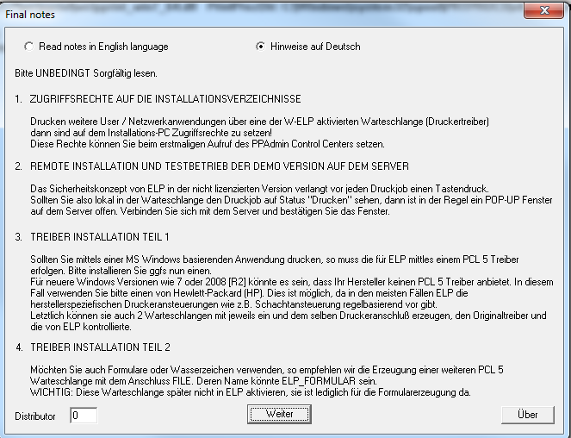
Installation on Windows and Start-Up Agent
After unzipping, just start the installer (msi file) and follow the steps described in the installation wizard.
If you get this screen, you´re almost done. Please read the notes carefully. On ELP start-up the software checks statement 1 and 2.
Installation

Slide 19
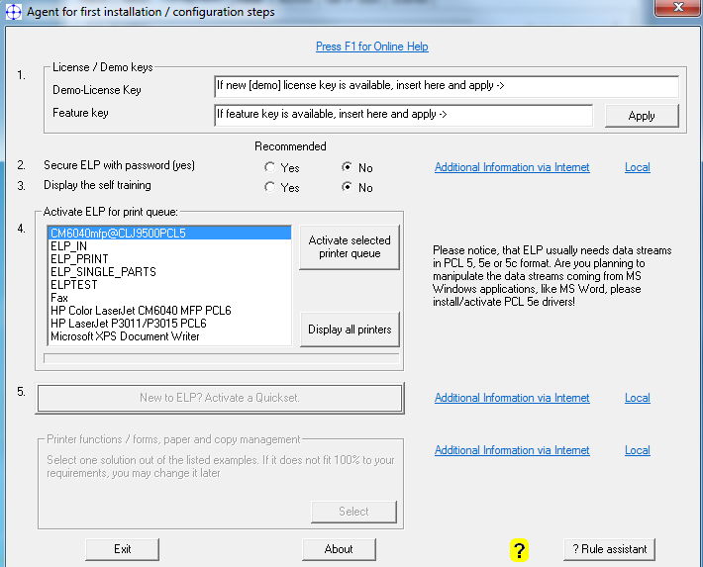
Start-Up Agent of PPAdmin Contol Center
This agent pops up if no printer queues are activated
You can enter a [demo] license key
A feature key (if available)
Can setup a password:
Study the self training
Activate queues
Installation

Slide 20
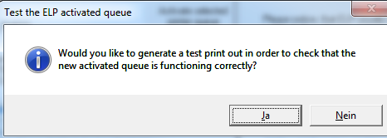
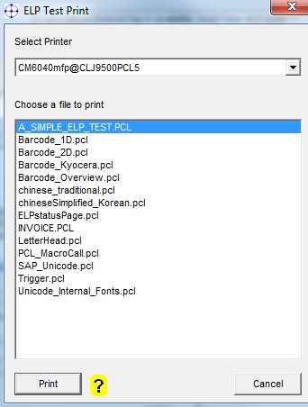
Queue Activation
Test Print
After activation of any queue, ELP suggest to generate a test print
Therefore click on yes
Select the printer queue for testing
Select the test file
  “A_SIMPLE_ELP_TEST.PCL”
Click on print
A page with a form and a few bar codes is printed
Installation

Slide 21
Start-Up Agent of PPAdmin Contol Center
This agent pops up if no printer queues are activated
You can enter a [demo] license key
A feature key (if available)
Can setup a password:
Study the self training
Activate queues
Check Quick Set samples or
Installation

Slide 22
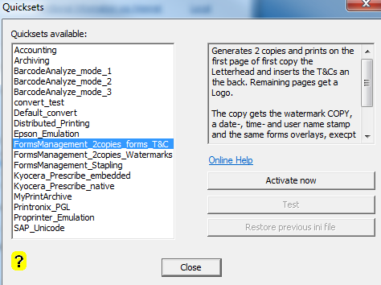
Quick Sets Dialog
Browse for a suitable
Quick Set
Study its description
If it fits your needs,
activate it
Each set comes with a sample test job which displays in most cases additional information.
Use the set “default_convert” to restore factory settings.
Installation

Slide 23
Start-Up Agent of PPAdmin Contol Center
This agent pops up if no printer queues are activated
You can enter a [demo] license key
A feature key (if available)
Can setup a password:
Study the self training
Activate queues
Check Quick Set samples or
Forms & printer mngt samples
Installation

Slide 24
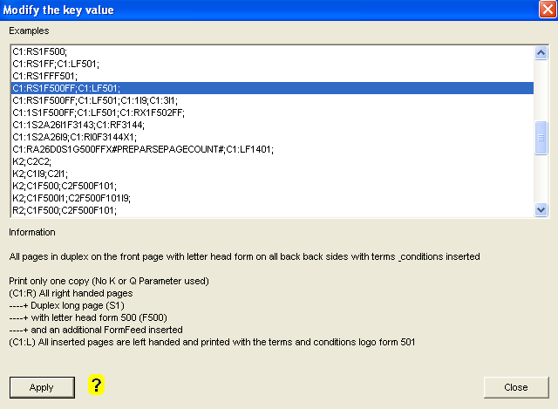
Forms & Printer Management Samples
Browse for a suitable
example
Study its description
If it fits your needs,
apply it
Send any print job (PCL5) to an ELP-activated queue
To deactivate this command remove the key “ELP_Command” from section GLOBAL in the the Configuration tab
Installation

Slide 25
Start-Up Agent of PPAdmin Contol Center
This agent pops up if no printer queues are activated
You can enter a [demo] license key
A feature key (if available)
Can setup a password:
Study the self training
Activate queues
Check Quick Set samples or
Forms & printer mngt samples
When done:
Exit the Start-Up Agent
Installation

Slide 26

PPAdmin Tabs
Introduction
Macro tab: Manage and generate macros ( = forms )
Admin tab: Recommendation: Configure the e-mail client to send notifications to admins or outbound e-mails.
Configuration tab: Setup the configuration and processes (main view)
Install tab: Activate and test printer queues, FleetMeter, Queue management
Archive tab: E-mail, view, reprint, delete or combine archived jobs
GetIPJobs tab: Manage a port listener for retrieving raw TCP/IP print jobs, send from other hosts
License tab: Deploy license, change language, check for required software modules (according to current configuration)

Slide 27
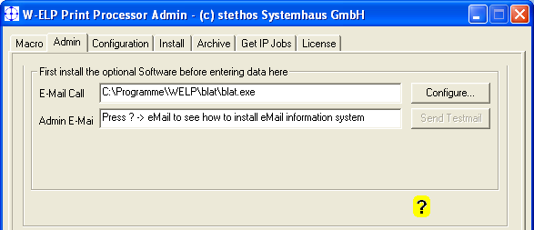
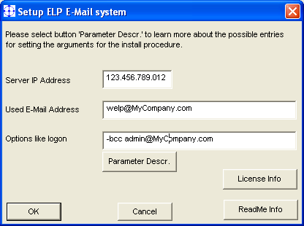
E-mail setup for admin notifications
Œ
In case a queue stops working,
the listed admins get a notification
e-mail.

’
“
The setting is also required for sending faxes or e-mails.
Ž


‘

Slide 28
Licenses
Notes:
On request is this presentation also available in PowerPoint format.

Slide 29
License modes under MS Windows
Unlicensed Demo pop-up on server for each job (for system user so please connect via ‘mstsc /console’) + watermark
Demo key No pop-up and no watermark until time-bomb explodes
Full license Does not expire,
Enables only the purchased software modules,
On usage of unlicensed functions or too many printer queues will add the demo pop-up and the watermark
Time-bombed full license
For click selling deals, one month before license expires
every day a reminder page will be printed.
Benefit: Your competition needs to repurchase, you need
only to renew the maintenance contract.
Multi server company license - On request

Slide 30
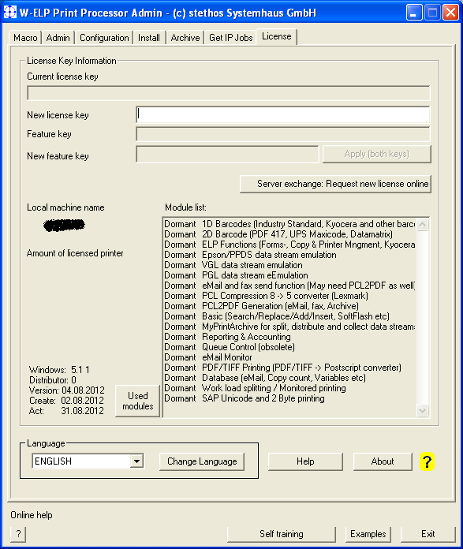
Licensing
Make sure that W-ELP Control Center was started with admin rights (right-click).
Open the tab „license“.
Enter the new license or demo key.
Enter the new feature key
(if available).
Click on „Apply“.
If you have internet connection a message about your license activation is sent to stethos. If you don´t have any internet connection the software will work none the less.
Online help: http://welp.stethos.com/online-help/license-tab.html
2.
3.
4.
5.

Slide 31
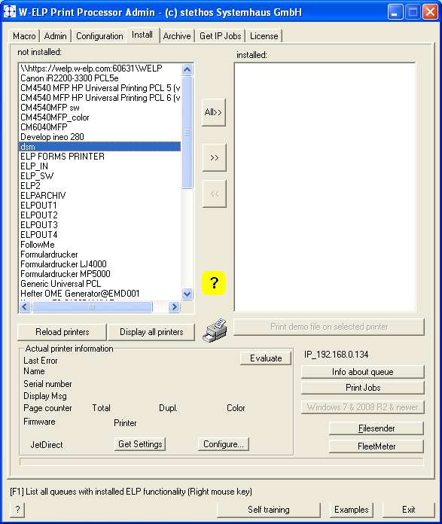
Activation of queues
Make sure that W-ELP Control Center was started with admin rights (right-click).
Open the tab „Install“.
Highlight your printer queue.*
Click on the button „>>“ to activate the queue.
Recommendation: Run the offered test.
Online help: http://welp.stethos.com/online-help/install-tab.html
* See online help in case your printer queue is not listed.
2.
3.
4.

Slide 32
Basic Features: Quick Sets
Notes:
On request is this presentation also available in PowerPoint format.

Slide 33
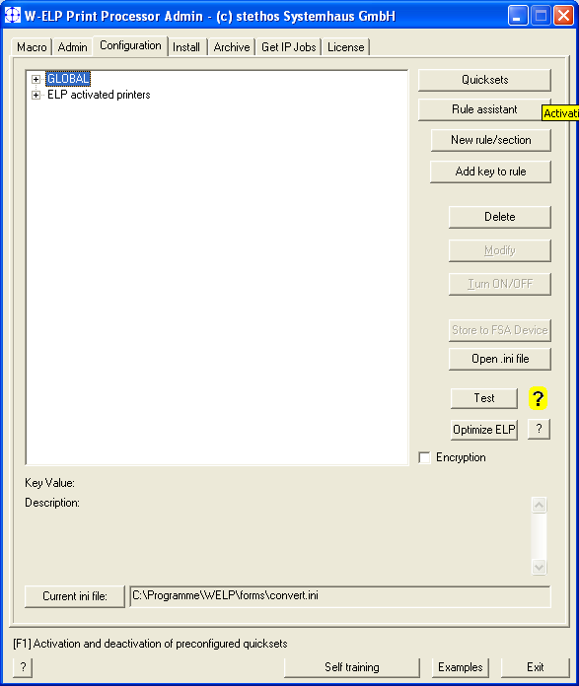
Quick Sets
Demonstrates basic features of ELP.
Same functionality as in Start-Up Agent.
Press F1 for help

Slide 34
Basic Features: Forms
Notes:
On request is this presentation also available in PowerPoint format.

Slide 35




ELP Output Management (OM)
Printing, Overview
Static form generation
with any software, simply
design and print to file
Color and B/W
Watermarks, Signatures etc
Install by click
Reprints with settings of
Paper trays,
Forms and Overlays,
Simplex/Duplex,
Out trays,
Stapling
Printer initialization
Setup by click
Banner pages,
copies
Logo, forms
T&C insertion
Varying copies
ELP Forms & Printing Management

Slide 36
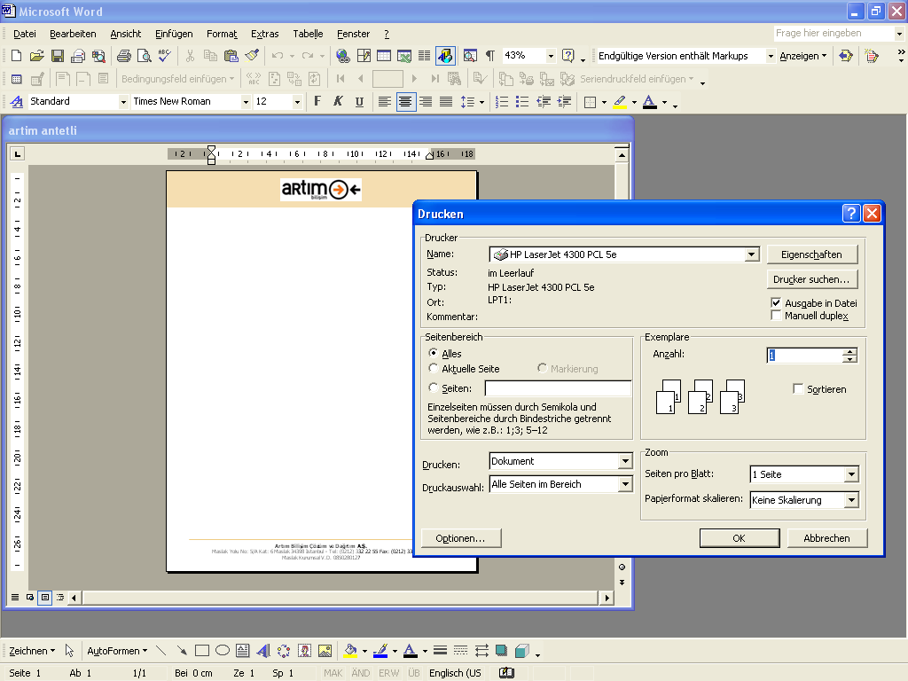
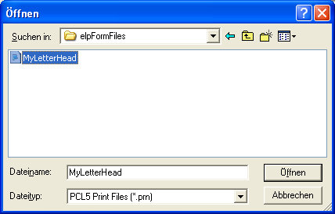
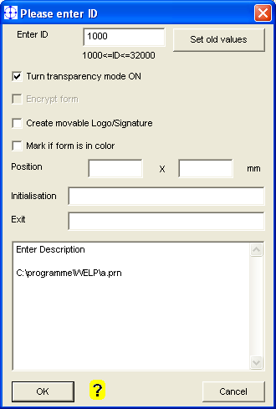
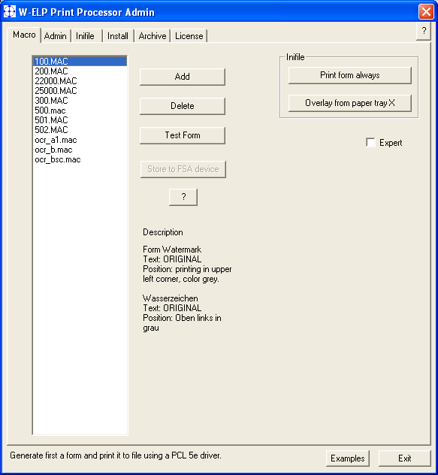

Forms generation
Œ


PCL 5 reference driver recommendations:
B/W: HP LaserJet 5200 PCL5e
Color: HP Color LaserJet 9500 PCL5c
Ž
” Open PPAdmin, tab config, add / select the ELP_Command in section GLOBAL, Modify, Generator, deselect form 500 and add the new form, close and reprint your test file.

“
‘
’
ELP Forms & Printing Management

Slide 37
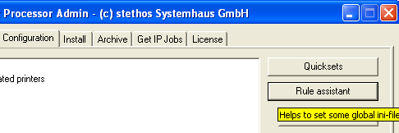
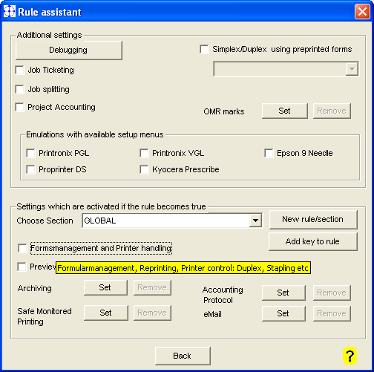
Forms and Printer Management
First time:
Config tab
Rule assistant
Forms management & printer handling
Changing:
Double-click on ELP_Command in rule
ELP Forms & Printing Management

Slide 38
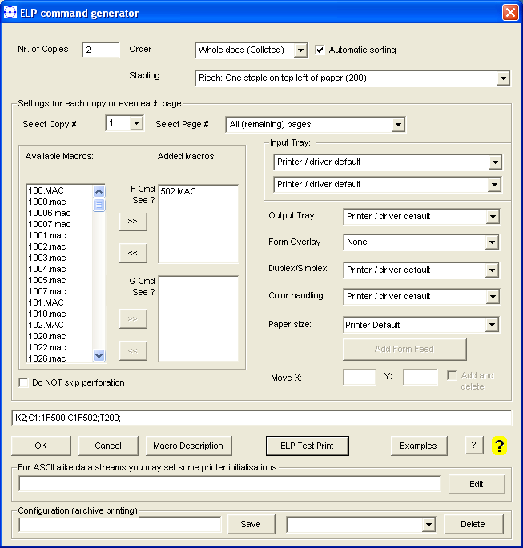
ELP Command Generator
Page / copy specific forms insertion
Reprints with stapling, punching , PIN, etc.
Paper management
In/out paper tray control ,
Simplex/Duplex,
Color Management
Insert FormFeeds (T&C)
…
PDF Preview
> 50 Sample settings
More Functions
Position prints
Do not print page
Auto. macro generation
Initalizations
Collections
…
ELP Forms & Printing Management

Slide 39
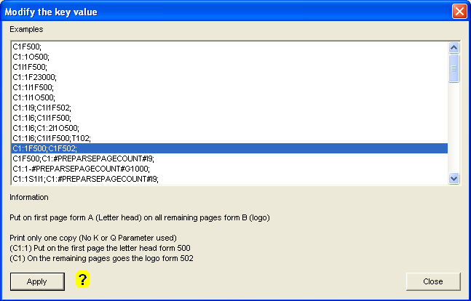
Example:
A letterhead on every page

Œ
Ž

A lot of examples for more complex scenarios.
See description after highlighting a sample.
ELP Forms & Printing Management

Slide 40
Forms Management
Original Data Stream
Copy 1: blank paper
1st Page: Duplex, Letterhead
Advertisement 1
2nd Page: Form: Terms & Conditions
3rd Page: Simplex, Letterhead
Advertisement 2
Color printer for nice invoices
Copy 2: simplex, but with
preprinted back page
advertisement
Pages: Letterhead, Watermark and
Advertisement 3
Page 1
Page 2
Copy 3: simplex, Letterhead and
time stamped Watermark
Black & white printer in bookkeeping department
ELP Forms & Printing Management
The power of ELP output management

Slide 41
ELP_Command page level analysis
Example: K2;C1:1F500;C1F502;D1;
C1P1* C1P3* C2P1*
X
X
1.
1. Step Search for C#:#...; Copy n page x
2. Step Search for C#:#-#...; Copy n pages x to y
3. Step Search for C#...; All (remaining) pages of copy n
4. Step Search for the D#; Use copy definition m as default
when no command Cn applies
2.
* ELP processes the copy number n and within page number m
After the page number analysis follows the page side analysis…
ELP Forms & Printing Management

Slide 42
ELP_Command page side analysis
Print job in Duplex, insert terms & conditions on each back page
Search for C#:R...; All right-hand pages (front pages)
Search for C#:L…; All left-hand pages (back pages)
C1:RS1FF;
C1:LF501;
Combination page side and page number:
C1:1F500;C1:RS1FF;C1:LF501;
Prints on first page the company letterhead and inserts on every back page the T&Cs.
ELP Forms & Printing Management

Slide 43
> 50 ELP_Command functions can be combined
Banner page
Colored water marks
Page-, Job-, any counter
Stapling
Last page tray handling
The 50 commands
EB22000;
C1:1G3000F500;
C1F25000;
T100;
C1:#PREPARSEPAGE
COUNT#I9;
ELP Forms & Printing Management

Slide 44
Exercise
ELP_Command
If time available:
Page 1: Letterhead form (500) and printed on plain paper
Remaining middle pages: Simplex and logo (502)
Last page: From tray with colored paper.
C1:1S1I1F500;C1S0F502;C1:#PREPARSEPAGECOUNT#S0I3;
What needs to be changed: Insert T&Cs on back page of the first page?
ELP Forms & Printing Management
ELP Output Management

Slide 45
Basic Feature: Applying Rules
Notes:
On request is this presentation also available in PowerPoint format.

Slide 46
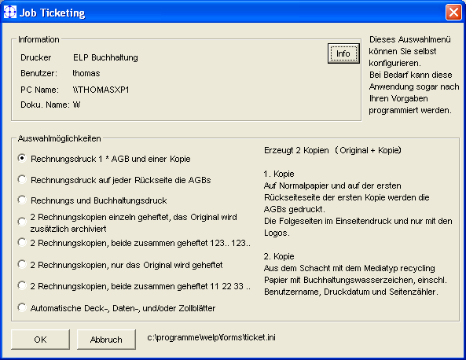
Rule Based Printing
Before reading the 1. Bytes
Fixed rule names
GLOBAL
For every job
User-name
Rules are
activated by default
Printer-name
Driver-name
Portname
Job ticketing
Project accounting
own rules
External
Software
Activate all functions by setting the proper keys

Slide 47
Rule Based Printing
Before reading the 1. Byte
Fixed rule names
While reading the
Data stream
Final analysis before
starting to write out
GLOBAL
Search
Binary
Windows[_New]
Text[_New]
Row/Col
Erase
Replace
Insert
Add
StoreNextWord
OR combined
Trigger rules
Primary rules:
Binary
Windows[_New]
Text [_New]
Secondary rules:
page size
Orientation
Resolution
Simplex/Duplex
User names
Printer names
Variables
AND combined per rule
If … then … else
Printer name
Rules are
activated by default
User name
Driver name
Port name
Job ticketing
Project accounting
own rules
External
Software
Automatic replace
variables
OutSearch
Activating all keys and processes

Slide 48
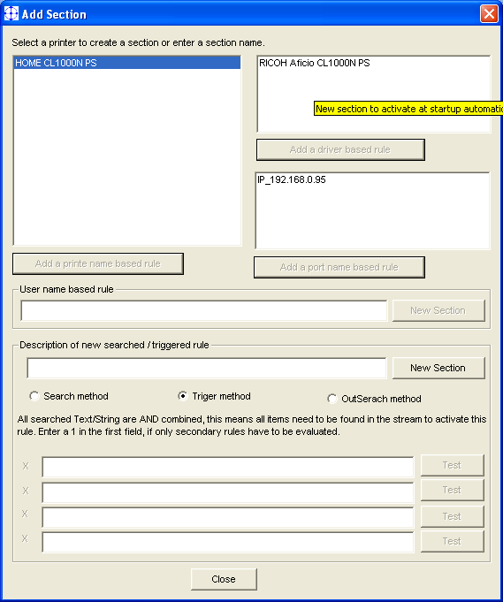
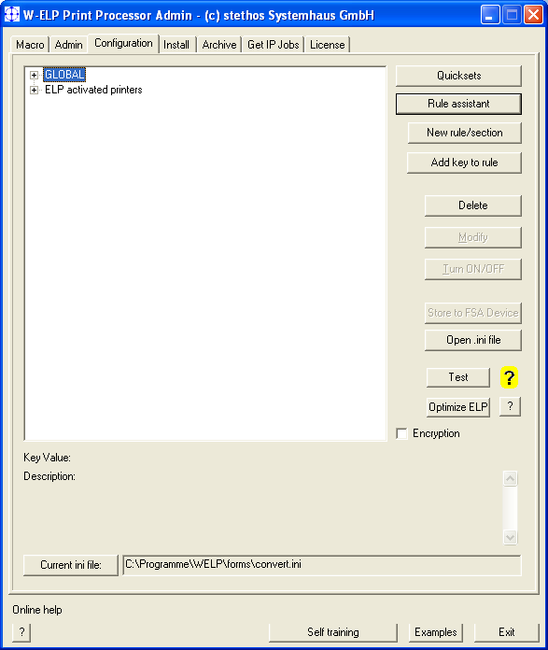
Define invoice printing for a specific queue, part 1
Ž
Œ

Ž
Rule Assistent

Slide 49
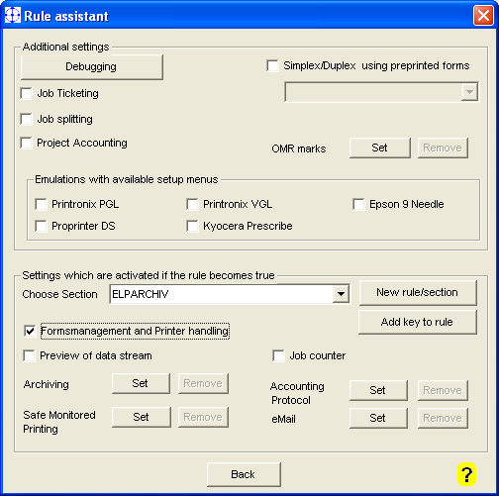
Define invoice printing for a specific queue, part 2
Call ELP_Command Generator for forms management

Slide 50
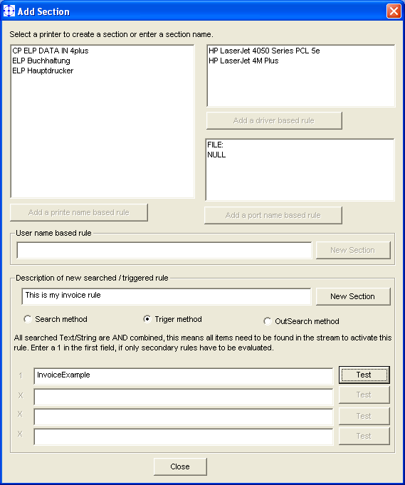
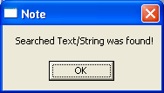
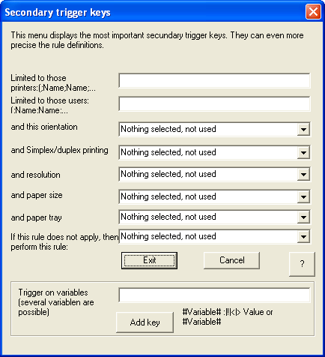
Rules, based on data stream content

Œ

Next Step

Ž


Slide 51
Search / Trigger Keys
OR combined
SEARCH_BINARY
any binary data, incl. Hex 00
SEARCH_WINDOWS[_NEW]
Positioning Sequences are ignored
SEARCH_TEXT[_NEW]
Like search_windows, but not case sensitive
Trigger_BINARY
Trigger_WINDOWS[_NEW]
Trigger_TEXT[_NEW]
SEARCH_ROWNO
Any printable information can be inserted at the
beginning of this row, or data stream text can
captured to variables.
AND combined
Let the test function decide which search/trigger method to use!!
Rule based printing

Slide 52
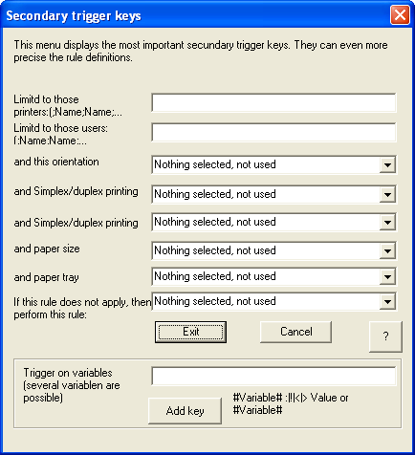
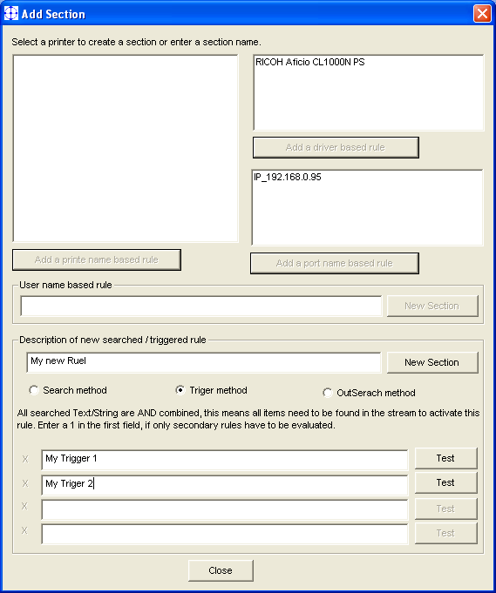
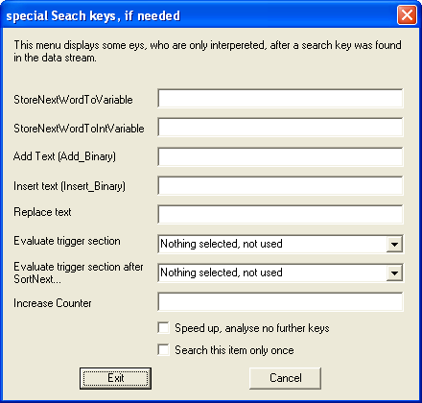
ELP Search / Trigger Keys

Slide 53
Data base and / or
Active Directory
User
ELP
Active
Directory
Trigger functions
Trigger_Variable=…
Use variables
in forms
Use variables for
Functions like:
- Pin Numbers
- Printer Ports
-…..
Performs a data base search for collected variables, e.g. Cust.No.
or User information
Read back the ELP command fields like
eMail Adresses
NoPrinting
CopyFactor
ERP
System
Export search infor-
mation like customer
numbers or addresses
and defines ELP
selectable commands
DBase
database
Rule based printing
Notes:
Performance Print benefit summary.

Slide 54
Basic Features: Variables
Notes:
On request is this presentation also available in PowerPoint format.

Slide 55
Some predefined variables
#PCNAME# (Job)
#HOSTNAME# (PC)
#PRINTDOCNAME#
#PRINTDOCNAME_UNI#
#PRINTERDRIVERNAME#
#PRINTERNAME#
#PRINTERSHARENAME#
#USERNAME#
...
#ACTTIME#
#DATENUM#
#DATETEXT#
#DATETEXT_D#
#DATETEXT_PL#
#DATESERIAL#
#MILLISECONDS#
#MONTH#
#MONTH_D#
#MONTH_PL#
#WEEKDAY#
#WEEKDAY_D#
#WEEKDAY_PL#
#TODAYNUM#
...
#IN_ELP_FILENAME#
#OUT_ELP_FILENAME#
#ELP_FORMS_PATH#
#ELP_PROG_PATH#
#LAST_ARCHIVE_FILE#
#RANDOM#
...
#JOB_COUNTER#
#PEPARSEPAGECOUNT#
...
#YourVariable#
ELP Variables

Slide 56
Variable Management
Searched Variable
Search + StoreNextWord or of page
from Row, Col, Length, SubString- functions
Loaded Variables
Variable-Files, passed in from external applications; environment variables
Search for any collected variable(s)
  in a DBase III or Active Directory and read back ELP control functions, like NoPrinting,e-mail addresses, …
ELP Variables

Slide 57
Variables Usage
Can be used in
Macros / forms e.g. watermarks, date stamps or [page] counters
For calculations like loops or counters
Triggering rules
Accounting
Transport information between jobs
ELP Variables

Slide 58
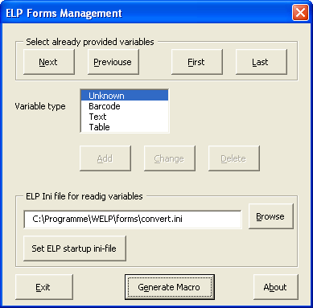
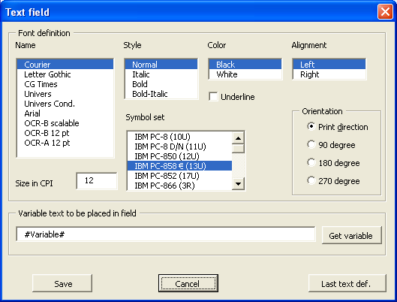
Variables Usage
Forms & Field Installer
Forms
Data stream
External applications
Reporting files
ELP Variables

Slide 59
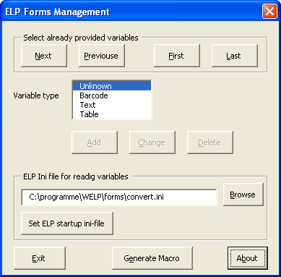
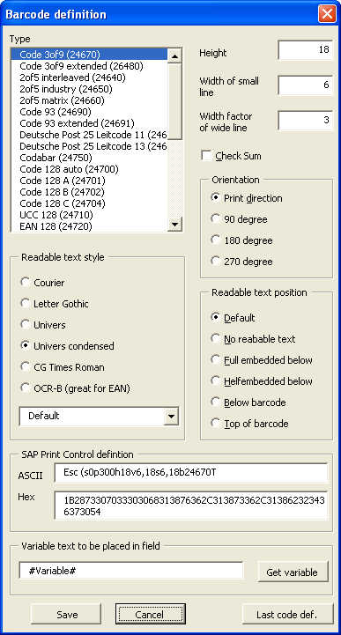
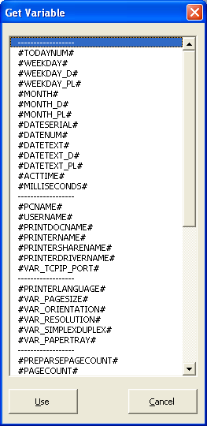
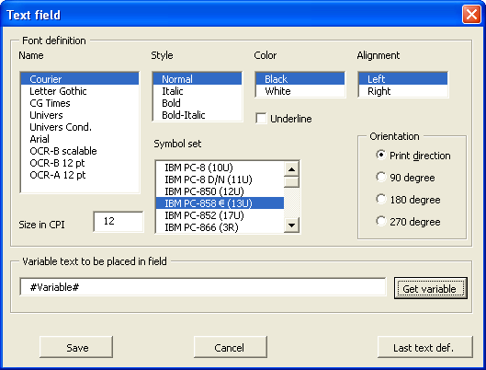
Variables Usage
Forms & Field Installer
Œ
Notes:
This part is also available on an USB Stock, to simply plug the software into an PC within any
Network, and scan all available printers.
This part of PPAdmin can be called even on regular scheduled base, will browse the network,
collect a lot of available information from any accessible printer and store the result in an CSV or
DBase file, which then can be either automatically send out by eMail to predefined addresses,
or directly opened within EXCEL. So it is easy for example to collect all page counts of the
printers or check the amount of available toner.
By default ELP / WInClick checks not only the printer page counter, but also reports how many
pages are printed in which size, simplex/duplex and color on which paper media, but for MFPs
as well, how many pages had been scanned in which size etc.

Slide 60
Basic Features: Bar codes
Notes:
On request is this presentation also available in PowerPoint format.

Slide 61


Bar codes
Barcodes
According to the industry standard,
SAP etc.
Over 60 one dimensional codes
Automatic checksums
Automatic data checking
Free scaling in X and Y direction
Two dimensional codes
PDF417, Data Matrix, Maxicode, QR Code
FreeEscape or Search + Replace
Barcoding in emulations:
Brother – OKI – Cobra Box – PSI
Postscript – Epson - Prescribe
OCR, Bar codes, OMR, Postal optimization

Slide 62
OCR A1 and B
OCR-B: European banking and postal address font
ABCDFE 12345
OCR-A1: German check printing
ABCDFE 12345 ²µ³
Both are automatically loaded into the printer when used in the data stream.
OCR, Bar codes, OMR, Postal optimization

Slide 63

MICR Printing
Magnetic Ink Character Recognition, or MICR, is a character recognition technology used primarily by the banking industry to facilitate the processing of cheques.
MICR is standardized by ISO 1004:1995.
The major MICR fonts used around the world are E-13B and CMC-7.
OCR, Bar codes, OMR, Postal optimization

Slide 64
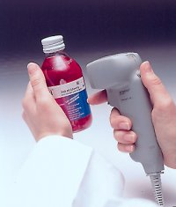
Bar codes in theory
A bar code is like text, only YOU mostly can’t read it
There are about 20 important types of bar codes.
The good thing is: The client tells you which one he needs
Bar codes are standardized ISO / DIN etc.
They are often industry specific (Car Industry Code 39)
OCR, Bar codes, OMR, Postal optimization
Barcodes in theory

Slide 65




Bar codes in theory
2-D Bar codes
All characters from 0 to 255
Up to 4 times 1.5K of Data
High redundancy (check sum)
Most common 2D bar code nowadays
UPS Maxicode
Data Matrix
PDF 417
QR Code
New!
OCR, Bar codes, OMR, Postal optimization
Barcodes in theory

Slide 66

Bar codes in theory
1-D Bar codes
Alpha-numeric Code 39 (3of9) 0-9 A-Z ./, space
Code 93;
Code 128; EAN 128 (Full ASCII)
Numeric only 2of5 matrix / industry / interleaved
Codabar
EAN 8 / 13, UPC A / E, MSI
Spezial KIX, FIM, Postnet
Full specification in the User-Manual and Technical Reference Manual
OCR, Bar codes, OMR, Postal optimization
Barcodes in theory

Slide 67



Bar codes in theory
1-D Bar codes Most important codes 123456
Code 39: *123456*
check sum optional
2of5 interleaved ‹p"8›
check sum optional
Code 128 Â,BXLÈ
always has a check sum
OCR, Bar codes, OMR, Postal optimization
Barcodes in theory

Slide 68



Bar codes in theory
1-D Bar codes Stroke/Space Ratio
Code 39 and 2of5 (interl): 1:2 … 1:3
All the others: 1:2 or EAN/UPC 1:2:3:4
OCR, Bar codes, OMR, Postal optimization
Barcodes in theory

Slide 69
Bar codes in theory
All you need to know:
Types: 1-D, 2-D and 3-D Bar codes
Coded data: Alpha-numeric; Numeric; full ASCII; 8 bit
Check sum: some have [optional] check sum,
2D/3D usually redundancy
additional user related check sums
Ratio 1-D: Code 3of9, 93, 2of5 interl. 1:2 up 1:3
OCR, Bar codes, OMR, Postal optimization
Barcodes in theory

Slide 70
Intelligent Bar code system
Font-like parameters description for 1-D bar codes!
P parameter Esc(s#p
Control if/how human-readable (caption) text is printed with bar code
0 Use default value
1 Don't print human readable text
2 Print human readable text embedded
3 Print human readable text half embedded
4 Print human readable text under code
5 Print human readable text above code
6 Print human readable text half above code
7 Print human readable text full embedded above code
Specials:
Add 10 to print UPC/EAN/JAN checksum middle left
rather than bottom left of bar code.
Add 10 to print start & end * characters with 39 bar
code text
Add 20 to format French and German postal barcodes
Add 100 to print checksum character with text.
Add 124 to print the German Post barcode
OCR, Bar codes, OMR, Postal optimization

Slide 71
Intelligent Bar code system
Font-like parameters description for 1-D bar codes!
h parameter Esc(s4p#h
Controls what font is used for the human-readable (caption) text
Format: CBA, numeric value, where
C: Style 0 Use Default (Bold)
1 Use Regular
2 Use Italics
3 Use Bold
4 Use Bold Italic
B: Size 0 Use automatic font size
A: Typeface 0 Use Courier to print text (default)
1 Use Letter Gothic to print text
2 Use Univers to print text
3 Use Univers Condensed to print text
4 Use CG-Times to print text
5 Use OCR-B to print text (great with UPC/EAN)
Example: text in Univers Bold Italic, automatic size: Esc(s…402h…
OCR, Bar codes, OMR, Postal optimization

Slide 72
Intelligent Bar code System
Font-like parameters description for 1-D bar codes!
Font-like parameters description for 1-D bar codes!
v parameter Esc(s4p102h#v
Short bar height in points (1/72 inch). Same unit as fonts. Minimum sizes apply.
Example: Bar code in point size 87: Esc(s…87v…
s parameter Esc(s4p102h45v#1,#2[,#3,#4]s
Space Widths
#1, bar width, first (thin) width in dots (1/600 inch)
#2, bar width, second width in dots (1/600 inch)
Code 3of9, 93 and 2of5 interleaved: #2 is between 2*#1 and 3*#1
all others #2 is 2 times #1
Only for EAN, UPC and Code 128 Bar codes please extend:
#3, bar width, third width in dots (1/600 inch)
#4 bar width, fourth width in dots (1/600 inch)
Example: Thin bars 4 dots, thick bars 8dots: Esc(s…4,8b….
b parameter Esc(s4p102h45v5,15s#1,#2[,#3,#4]b
Bar Widths (same as bar width)
OCR, Bar codes, OMR, Postal optimization

Slide 73
Intelligent Bar code System
Font-like parameters description for 1-D bar codes!
t parameter Esc(s4p102h45v5,15s5,14b#T
24600, UPC-A 24620, EAN/JAN-8
24601, UPC-A +2 24621, EAN/JAN-8 +2
24602, UPC-A +5 24622, EAN/JAN-8 +5
24610, UPC-E 24630, EAN/JAN-13
24611, UPC-E +2 24631, EAN/JAN-13 +2
24612, UPC-E +5 24632, EAN/JAN-13 +5
24640, 25 interleaved 24650, 25 industrial
24641, 25 interl + CHK 24651, 25 indust + CHK
24642, German Postal 25 13 24660, 25 matrix
24643, German Postal 25 11 24661, 25 matrix + CHK
24670, 39 (3of9) 24700, 128 autoswitch
24671, 39 + CHK 24701, 128 A
24672, 39 encode space 24702, 128 B
24673, 39+CHK encode 24703, 128 C (obsolete)
24680, 39 extended 24704, 128 C
24681, 39 extended + CHK 24710, UCC-128
24675, Danish PTT 39 24720, EAN 128
24676 French Postal 39 A/R
24770, ZIP+4 POSTNET 5 24690, 93
24771, ZIP+4 POSTNET 9 24691, 93 extended
24772, ZIP+4 POSTNET 11
23591, USPS ZEBRA 24750, CODABAR
24644, USPS 25, Tray Label 24751, CODABAR +CHKmod16
24645, USPS 25, Sack Label
24785, Australia 4 State 37-CUST
24760, MSI
24786, Australia 4 State 52-FF-MET
24761, MSI +CHK10
24787, Australia 4 State 67-FF-MET
24762, MSI +CHK10+CHK10
24788, Australia 4 State FCC-45
24763, MSI +CHK11+CHK10
24780, Singapore 4 State
Non standard JetMobile Barcodes:
24823 BCUPS
BCPZN
BCFIM
BCEANVELO
BCUPC128
24810 BCCODE11
24811 BCCODE11_C
24812 BCCODE11_CK
24805 BCKIX
OCR, Bar codes, OMR, Postal optimization

Slide 74
Intelligent Bar code System
Font-like parameters description for 1-D bar codes!
parameter Esc(s#p
1 to 8: defines the ECC level
1000 to 1400: defines the ECC level based on the size of the
codeword relative to the data size, in percent (0 to 400). The matching Ecc level will automatically be calculated.
parameter .....#1,#2,#3[,#4]b
#1, Maximum number of columns for the PDF symbol
#2, Maximum number of lines for the PDF symbol
#3, =1 #1 and #2 are the mandatory size for the PDF symbol
=0 or not specified: #1 and #2 are maximum size (default)
#4, =1 The PDF-417 symbol is truncated on its right side
=0 The PDF-417 symbol is not truncated (default)
Example: 8 columns, 10 lines mandatory size, none truncated: 8,10,0
parameter ....#1,#2[,#3,#4]s Symbol format parameters
#1, X parameter for the symbol X/Y size ratio (default: 2 for 2/3)
#2, Y parameter for the symbol X/Y size ratio (default: 3 for 2/3)
#3, Symbols black/white module height (1 to 10). Unit=minimum
module width (default=3)
#4, For future use
Example: square PDF, minimum module width: 1,1,1
T parameter ....24850T See previous slide
OCR, Bar codes, OMR, Postal optimization

Slide 75

Intelligent Bar code System
Example
<27>&fS Push cursor position (save)
<27>&a5000h2000V Positioning in 1/720 units per inch
<27>&a90P Rotate 90 degrees*
<27>(s4p102h40v10,20b10,20s24670T Select barcode (3of9 ratio 1:2)
BARCODEINFORMATION Barcode information
<27>(0N<27>(sp10hsb4099T Select any font from PCL font list
<27>&aP Original printing direction*
<27>&f1S Pop cursor position (restore)
<27> is Hex 1B or ASCII 27
Example with MS Word PCL 5 driver using the print field:
{PRINT 27 "&fS" 27 "&a5000h2000V" 27 "&a90P" 27 "(s4p102h40v10,20b10,20s24670TBARCODEINFORMATION" 27 "(10U" 27 "(sp10hsb4099T" 27 "&aP" 27 "&f1S" \* MERGEFORMAT }
Minimum bar code definition
OCR, Bar codes, OMR, Postal optimization

Slide 76
Intelligent Bar code System
Example
Example with MS DOS EDIT:
←&fS←&a5000h2000V←&a90P←(s4p102h40v10,20b10,20s24670TBARCODEINFORMATION←(10U←(sp10hsb4099T←&aP←&f1S
Esc: Strg+P Alt+27
copy /b filename \\PCName\PrinterShareName
SAP:
OSS note: #5196 lists standard R/3 bar code names
OSS note: #45643 lists PCL-5 command details for bar code attribute selection
SE73 transaction lists barcode names
SO10, SAPSCRIPT-BARCODETEST (client 000)
SPAD – select device types – add print control: Use in SAP script
For Unix/Linux printing via Pearlscript see ELP documentation
OCR, Bar codes, OMR, Postal optimization

Slide 77
Intelligent Bar code System
Tips
Kyocera emulation:
ELP is able to handle all PreScribe Bar code statements!
ELP handles more the 80 other PreScribe commands.
SAP (no bar code printed):
In 80% wrong device type (print-control not available)
In 15% client use windows driver printing SAP-WIN
User Data Error is printed with an X in bar code
See manual for error information
Never print data stream through a windows driver!
OCR, Bar codes, OMR, Postal optimization

Slide 78
OMR codes for envelope machines
Stielow / Neopost / Hefter / PFE
Pitney Bowes / Kern
Automatic insertion detection
Sequence control / Match codes
Parity
Postal optimization (Archive)
Position, Lines free configurable
Optional reverse [duplex] printing
OMR BarDIMM Emulation
OCR, Bar codes, OMR, Postal optimization

Slide 79
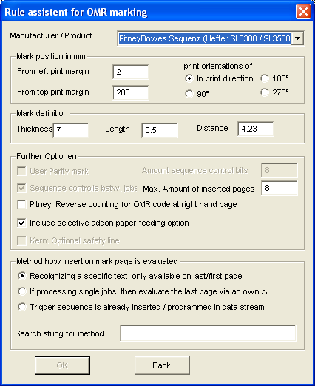
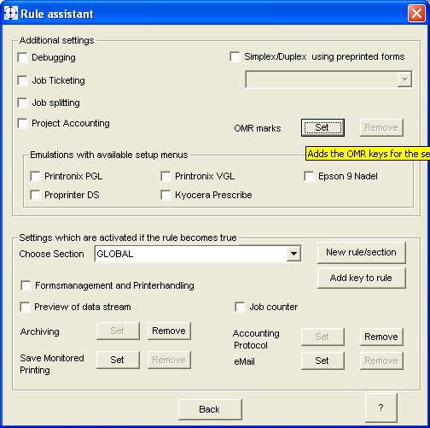
OMR codes for envelope machines
Œ
Œ
OCR, Bar codes, OMR, Postal optimization

Slide 80
Basic Features: Archiving
Notes:
On request is this presentation also available in PowerPoint format.

Slide 81



Archiving
- as PDF / PCL / or any other data stream format
- Index file possible
- Stored to project-, user- and or group-directory
- In / Outgoing streams
- Reprinting
- Single jobs, booklets
- Copies
- Postal optimization
Using collection variables as filenames
Archiving works with all kind of data stream formats, PDF conversion with PCL 5 and PCL 6!
Archiving

Slide 82

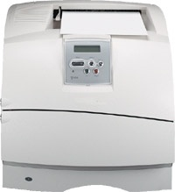
Collect4Printing
Standard print job
Sent all archived jobs
Select/Reprint/Staple Jobs
ELP Monitored
Queues
With Trigger
With Trigger
Printer A
Printer B
MyPrintArchive
User B
User A
Send / Distribute all archived jobs to any available printer.
Collect and sort
data streams,
e.g. User sorted
Archiving

Slide 83
Collect4Printing
Rule Settings
[Collect4Printing]
; All jobs are printed through this named queue to local port NULL
; Store file to archive directory, coding the user name and time
OutArchiveDir=#ELP_FORMS_PATH#archive\#USERNAME#;#DATESERIAL#
; If print files are older then 5 days erase them
ArchiveDays=5
Exit=ON
User A
!PrintAll!
Send
via
Batch file
to queue
[Print all]
Trigger_Binary=!PrintAll!
; All stored jobs are inserted at actual jobs end
InsertPrintFilesAtJobEnd=#ELP_FORMS_PATH#archive\#USERNAME#\*.*
; and the trigger job is not printed
KillJob=ON
Archiving

Slide 84
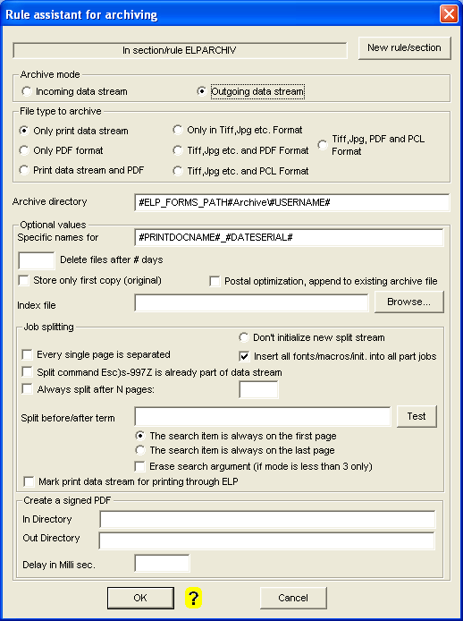
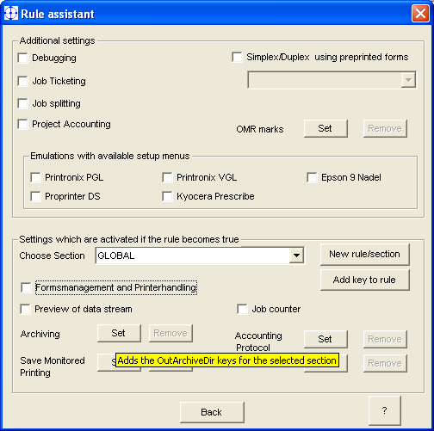
Archiving
Ž


‘
’
Œ

“
”
Archiving

Slide 85
Archiving Options
Collect4Printing
- Collect Data streams
- Send them as one Job to
any available printer
- staple them
User A
Print job splitting
- Separate big jobs into
single documents
- Work load balancing
- Postal optimization
Insert stored data streams
attach data streams, data sheets
on the fly
Archiving

Slide 86
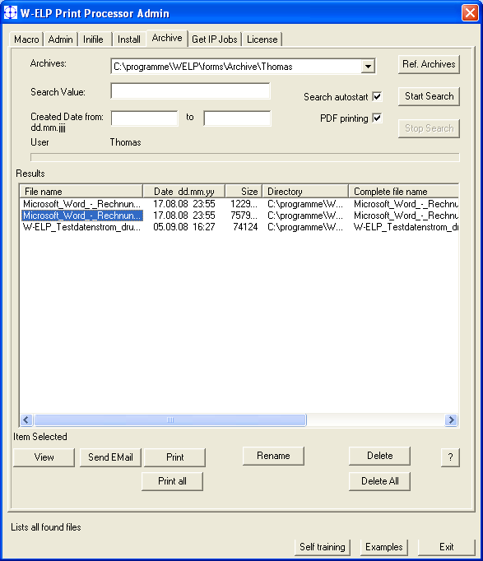
Archiving:
Search and View
Access to all archives
Stores the print data stream and / or PDF format
smart search routines
reprint, email, view function
Collect and print jobs
Optional: Delete jobs after X days.
Generate index files for professional archive systems
Archiving

Slide 87
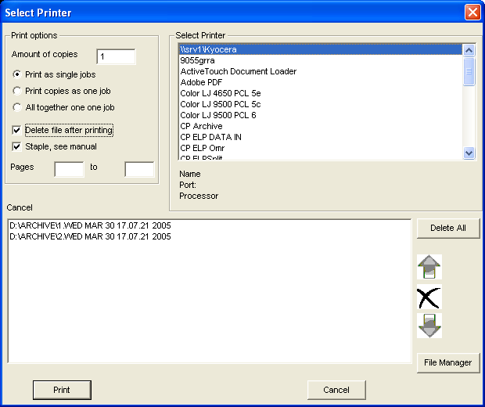
Archiving: Print
Sort collected print streams, booklets
Drag & Drop new streams
Select destination printer
Staple, Delete printed jobs
Reprints from to page
User specific PPAdmin with Archive tab only.
Archiving

Slide 88
Create searchable
PDF documents
Problem:
Modern Windows drivers don´t encode readable text with a standard symbol set.
Solutions:
ConvertSoftFont2ISO=ON
When activated ELP tries to convert all TrueType font based texts from the Windows stream based coding, into ISO. As a result, the PDF converter creates searchable PDFs.
RemoveDownLoadFont=ON
Deletes the complete softfont information from the data stream and replaces it with definable printer internal fonts.
See online help for further details. (All ELP commands)
Archiving

Slide 89
Advanced Features: Digital Signature

Slide 90
Digital Signatures
Digital signatures are often used to implement electronic signatures
In the European Union, electronic signatures have legal significance
W-ELP supports software certificates (PKCS#12) and various SmartCard manufactures
Depending on the local law and the level of security needed the proper signing method has to be chosen
SmartCards do need of course a suitable reader

Slide 91

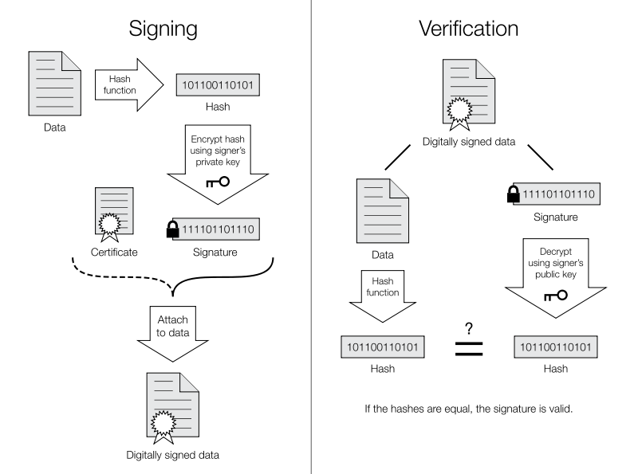



Signing (W-ELP) Verification

Slide 92

Digital Signatures
Rule Assistant
Set Archive
Notes:
This part is also available on an USB Stock, to simply plug the software into an PC within any
Network, and scan all available printers.
This part of PPAdmin can be called even on regular scheduled base, will browse the network,
collect a lot of available information from any accessible printer and store the result in an CSV or
DBase file, which then can be either automatically send out by eMail to predefined addresses,
or directly opened within EXCEL. So it is easy for example to collect all page counts of the
printers or check the amount of available toner.
By default ELP / WInClick checks not only the printer page counter, but also reports how many
pages are printed in which size, simplex/duplex and color on which paper media, but for MFPs
as well, how many pages had been scanned in which size etc.

Slide 93
Digital Signatures with W-ELP
W-ELP signs PDF’s – so the PDF Generator and Windows is a pre-requisite
Currently only 32 Bit Windows is supported
30 day trial version with a revoked Software certificate available on request (so not bundled with the “normal” standard download)
If a SmartCard certificate has to be extracted and used please contact stethos BEFORE starting the project if the type of SmartCard is supported
Usage: e.g. legal electronic invoices or archiving purpose

Slide 94
Advanced Features: Distributed Printing

Slide 95



Distributed Printing
Work-
station
Other Server
Report
ELP
Server
Archive
Printer / Archive at
different locations
Distributed Printing

Slide 96




Additional copy on different printer
If needed add a new printer queue and share it
Œ



‘
‘
\\#HOSTNAME#\Sharename
\\127.0.0.1\ Sharename
Distributed Printing

Slide 97


Split [Mail merge] Jobs
If needed add a new printer
and share it
Œ

Send splitted parts to this queue
Create an own rule fo this queue
Distributed Printing

Slide 98



Job Distribution
Split files according:
Big stream into single jobs
File Size
Amount of Pages
Desk / Dept. / Print Center
Work load balancing
Distributed Printing

Slide 99
Job Distribution Examples
[Ricoh Aficio SPC 420dn]
DISTRIBUTE_SECTION=SmallPrinter
[Kyocera FS-2000]
DISTRIBUTE_SECTION=MediumPrinter
[SmallPrinter]
Distribute_FileSize=4000000,\\Servername\PrinterShareName1
Distribute_FileSize=2000000,\\Servername\PrinterShareName2
[MediumPrinter]
Distribute_PageCount=50,\\Servername\PrinterShareName1
Distribute_PageCount=200,\\Servername\PrinterShareName2
Distributed Printing

Slide 100

Workload Balancing
24 %
32 pages per minute
38 %
50 pages per minute
Huge print job
38 %
50 pages per minute
Distributed Printing

Slide 101

Store private jobs on printer HDD
User pulls his
documents from the printer harddisk with his pin number
ELP
Any
Application
on any
System (Host)
Gets User Name
Gets User PIN from ELP Database
Inserts the private PIN command
Question:
Why just only user-sorted?
Tour numbers? Region codes? Any other criteria which can be found in the data stream...
Distributed Printing

Slide 102
Advanced Features: Reporting and Accounting
Notes:
On request is this presentation also available in PowerPoint format.

Slide 103

Reporting and Accounting „light“
Data stream
analyses
Project Accounting
Windows
Spooler
UNIX
Command line
ELP - VM
Variables
Management
Active Directory
From external
Variable files
any Software
Data Base
File formats
DBase or
CSV
Reporting & Accounting

Slide 104


Reporting and Accounting „light“
Each job generates one record into any associated reporting data base.
Every DB can hold any collectible data.
Œ
Œ

Report file:
Reporting & Accounting

Slide 105




Cost or project tracking
0020701028
0020701028
Activation
Œ

Dialog opens for each job
Ž Accounting file is created
Reporting & Accounting

Slide 106

Job Ticketing
Apply for job a print setting:
E.g. Watermarks on copies, stapling, punching
Œ
Defines max 8 settings
Job Ticketing

Slide 107
Advanced Features: E-mail
Notes:
On request is this presentation also available in PowerPoint format.

Slide 108
E-mail and fax
e-mail addresses
Predefined
collected in data stream (e-mail)
searched in data base
from Active Directory
e-mail body text (only e-mail)
selectable according to data stream, variables personalize the document
Attachment
Data stream
Job as PDF, PDF/A, signed PDF or TIFF
T&Cs, data sheets etc.
Other functions

Slide 109


Sending e-mails
Œ


Ž
Other functions

Slide 110
Advanced Features: Emulations & other solutions
Notes:
On request is this presentation also available in PowerPoint format.

Slide 111

Emulations with ELP
PDF Direct
ASCII Output (Erase PCL)
Kyocera PreScribe
EPSON FX 100
Printronix PGL
Printronix VGL
Hex dump
PCL scaling
PPDS
Philips emulation
CALS
Postscript
Tiff/Gif
Search and Replace!
Other functions

Slide 112


Emulation Settings
2 examples for emulation settings
Other functions

Slide 113
Safe Monitored Printing
ELP
Printer availibility
Monitor Printing
Accounting
prints
IP / printing
Notification
Wait time
SNMP verification
Reprint
- total
- collect jobs
- pages from/to
Error Management
Wait time over
Accounting
Archive job | Erase job | Just Continue | Send to other printer
Other functions

Slide 114


Safe Monitored Printing
Œ
Other functions

Slide 115


FleetMeter
Tracking & Reporting
Freeware after the first license
Available as standalone application on USB key -> portable
Reads complete MIB if needed
Fully customizable
Sends results periodically as e-mail
No add-on charges
CCT: Counter Calculation Tool is free as well
Other functions

Slide 116



Freeware
MS Windows only
Queue Management
Get IP Jobs
Filesender
Other functions
The power of ELP output management

Slide 117


Encryption and Compression
Encrypting data streams makes printing via un-save lines very save. Every printer may have his own keys.
Encryption_Keys=1234 12345 4321 56543
To save band with ELP can also compress the data stream up to 50%.
Other functions
The power of ELP output management

Slide 118

Unicode / Asian Printing on every PCL5 capable device
Notes:
Benefit: Western Europe AND Asian characters in one print job (ex. from SAP) being able to be printed on any device
in the wold.
If the device is NOT PCL5 capable, it can be turned into PDF and printed directly using Adobe Acrobat reader in a
surprisingly fast time.

Slide 119
Miscellaneous functions
Don´t
print
Traymap
Collect, sort and
staple data streams
Report line
generator
and more …
Execute any Software
Reverse printing
Booklet printing
Other functions
The power of ELP output management

Slide 120


Support and error handling
Œ
ŒŽ‘’“”

Set debug protocol
Fill in the contact data
Start Print Job
Check if ELP stored your print files, send the collected information to your support address.
Ž


My problem is that I won´t get the….
Detailed description
0123-456-789
me@mycompany.com
‘
Other functions
Notes:
Performance Print benefit summary.

Slide 121
Wrap up
Notes:
On request is this presentation also available in PowerPoint format.

Slide 122




Summary I http://welp.stethos.com/e_overview.html
Rules
Forms & Printer Functions
Security

Slide 123




Summary II http://welp.stethos.com/e_overview.html
Bar codes, OCR,
OMR, MICR
Archiving
Job Distribution
Ticketing

Slide 124


Summary III http://welp.stethos.com
10 minutes product video
Click on any item
to get more information
Notes:
http://www.welp.stethos.com/

Slide 125
Even more…
Yes, there are
much more
functions...
and think
what ELP can do for you?
If
You combine all
FUNCTIONS!
The power of ELP output management
Notes:
On request is this presentation also available in PowerPoint format.

Slide 126

Thank you
Who shows
competence
in [printer] solutions
generates
confidence
at the customer.
W-ELP
then you know it works!

